Slide 1

Hotel Cancellation Prediction

Slide 2

Business Challenge
This dataset contains relevant data from local hotels in the travel industry
The aim of this project it to observe hotel cancellation tendencies in travel business to ascertain patterns and predict order importance in customer behavior.

Slide 3
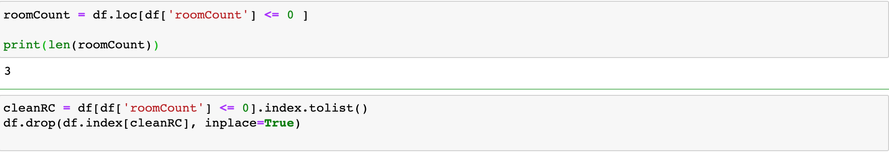
Data Pre-Processing
Remove unnecessary columns
Handle data anomalies
For project purposes, there was only one column in the data-set with anomalous data.
Handled by removing all instances where there were orders with no room counts.

Slide 4
Data Exploration
Find out which variables most influence hotel cancellation
Using various factors, visualize the factors that influence hotel cancellation

Slide 5
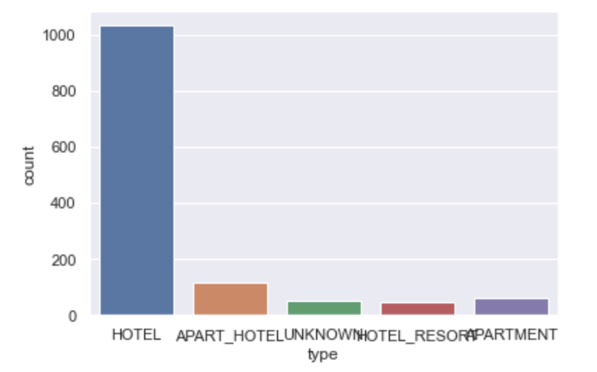
What Type of Residence is Most Likely to Cancel
Type hotel has the most cancellations by a significant margin.
Makes sense due to most travel expenses overnight for business trips would be on hotels.

Slide 6
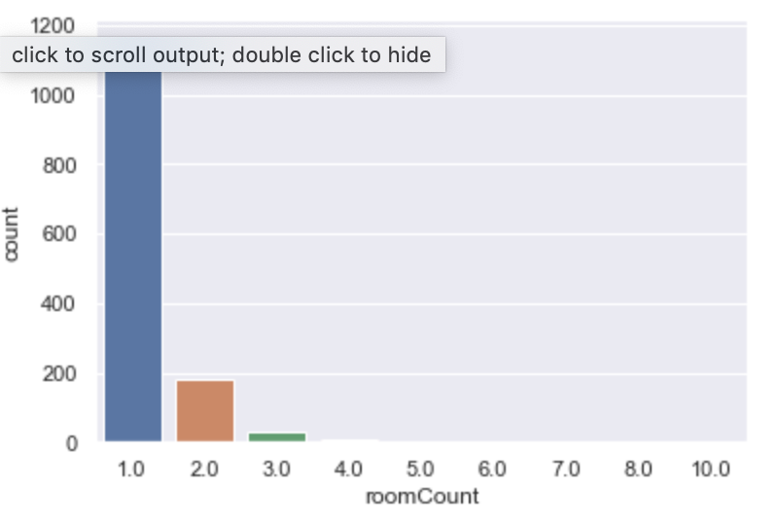
Which Room Count Received The Most Cancelled Orders

Slide 7
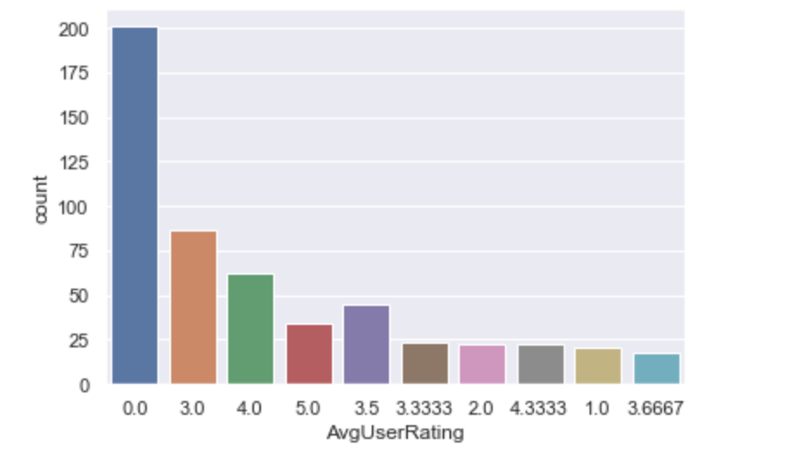
Which Ratings Received The Least Cancelled Orders
The average user rating of 0 received the most cancelled orders by a significant margin

Slide 8
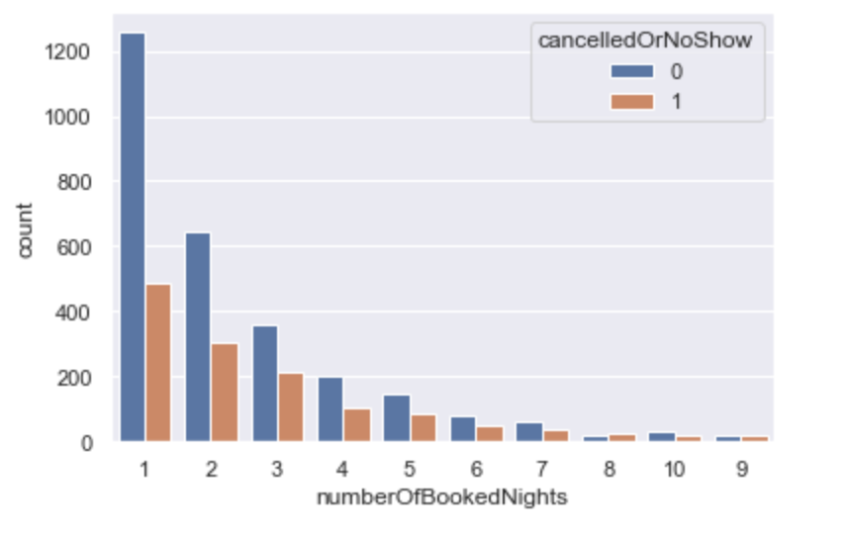
Is There A Relationship Between Canceled Orders And Number of Booked Nights?

Slide 9
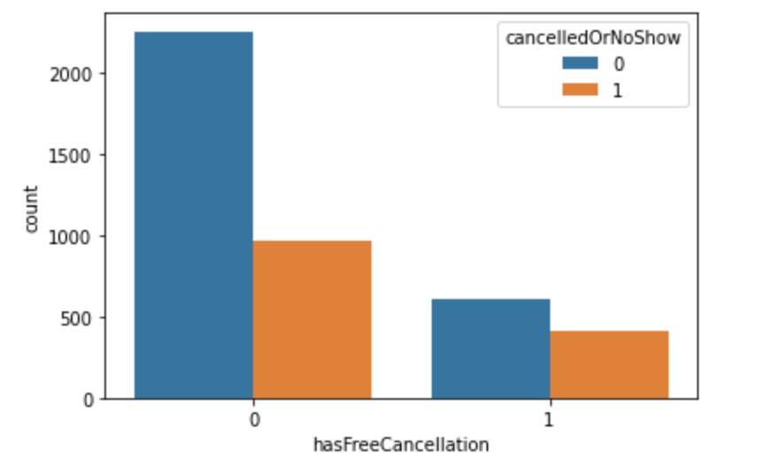
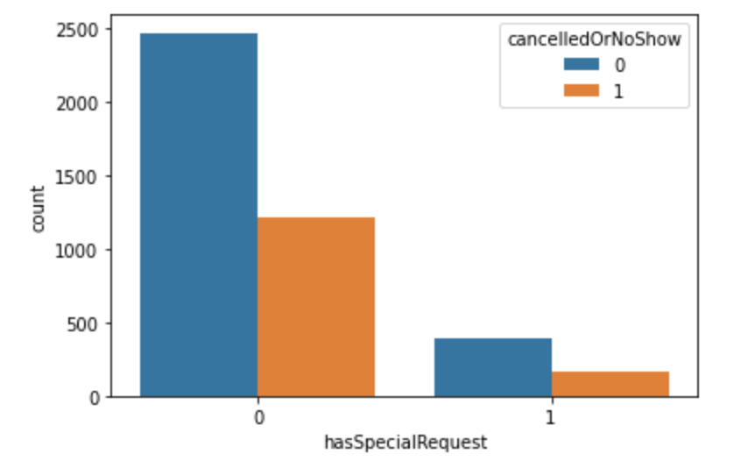
Is There A Relationship Between Special Requests And Canceled Orders?
Yes, there’s a relationship
Clients that have a free cancellation or a special request are much less likely to cancel their stay

Slide 10
Data Modeling
Use various machine learning techniques to help find which model helps best predict future cancellations.
Based on findings of EDA, all 3 models will only use select columns instead of all the columns
This is so that the model will hopefully give a more accurate indication of future cancelled orders

Slide 11
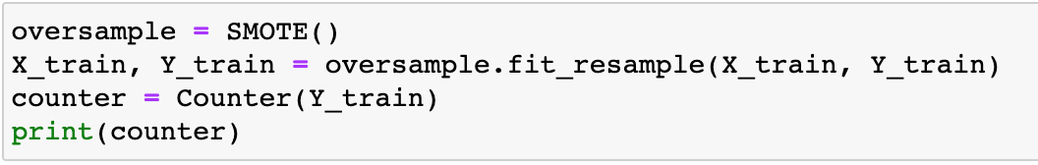
Synthetic Minority Oversampling Technique (SMOTE)
Data is imbalanced with a few categories such as 5 star hotels only having a few records
Problem with imbalanced data is that it produces biased predictions
SMOTE will help multiply an instance by a random n amount to help account for the difference between neighboring incidents

Slide 12
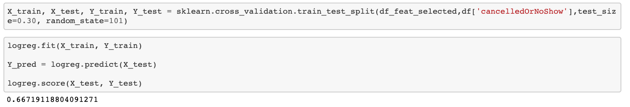
Logistic Regression
An algorithm for classification
Helps find relationships between features and a particular outcome
With a score of 0.667, my model is semi-accurate, and it implies that my predictor variables are good indicator of future hotel cancellations

Slide 13
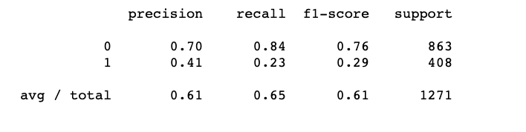
Random Forest Classifier
Helps select random samples from a dataset
Using each sample, constructs a decision tree
Then performs a vote for each sample with an associated predicted result
Hotels will want to identify customers who are ultimately going to cancel their booking with greater accuracy, thus recall is a better measurement to use
My recall score is 0.65. Mildly, but not thoroughly accurate

Slide 14
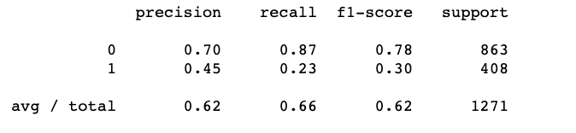
Decision Trees
Supervised, non-parametric learning method that is used for classification
Helps create a model that is inferred from the data features by predicting the value of a selected variable through simple decision rules
Will use recall over precision as hotels will want want to know which customers will ultimately cancel their orders
With a recall score 0.66, my model could be better, but it's usable

Slide 15
Comparison of Models & Conclusion
Used three machine learning models: Logistic Regression, Random Forest, and Decision Trees
None of them were particularly accurate, but do lend credence on the fact that the number of booked nights, the average user rating, and the room count can help predict and identify future cancellation trends
Accuracy for all 3 models in the 60s, but Logistic Regression was the most accurate with 0.67.
A more accurate model could have been accrued if columns were combined.

Slide 16

Thank You!

